Slide 1

TEST OR PLAY? REALISTIC EVALUATION OF ANTI-PHISHING UI
2017

Slide 2
Outline
Introduction
Anti-Phishing Defenses
Phishing Attacks
Hypotheses
Experiment Results & Analysis
Conclusions

Slide 3
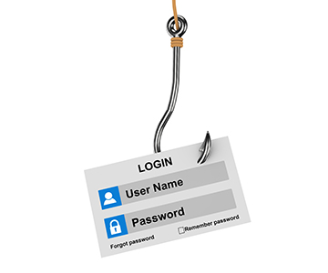
Phishing
An attempt to obtain sensitive information
such as usernames, passwords, and credit card details
By a malicious party
which disguises as a trustworthy

Slide 4
Common Defense
Browser Passive Indicators
Address bar, http/https prefix, padlock
Users may not understand or pay attention to these passive indicators
(Schechter et al., 2007; Karlof et al., 2009 and more)
Notes:
Apparently, most web users may not understand or pay sufficient attention to these
indicators, and tend to ‘automatically’ submit their credentials in login forms.
This occurs even when users are aware that they are being tested in phishing attacks
experiments.

Slide 5
Related Works
Interactive UI Mechanisms
Changes in the browsing ceremony
Tools and toolbars (not our scope)
Education and Training

Slide 6
Related Works
Interactive UI Mechanisms
Changes in the browsing ceremony
Before users can log into a trusted website, they are asked to identify an agreed-upon image, displayed with three random images (Herzberg and Margulies, 2011)
Clicking the power button on Android Zirco browser causes different results, based on whether or not the site is trusted (Jakobsson and Siadati work, 2016)
Many other works (see thesis)
Notes:
Force and/or encourage users to change their browsing behavior.
Non-representative environments: site-based or special browser.

Slide 7
Related Works
Hide this foil, just mention works in a bullet `many other works (see thesis)
Interactive UI Mechanisms
Tools and Toolbars
Pop-up warning are more effective than browser passive indicators and three evaluated security toolbars (Wu et al., 2006)
Mapping between sensitive information and where this information “belongs” to (Kirda and Kruegel, 2005)
Various tools for prevention and detection of phishing email attacks (e.g., Firake et al., 2011)
Notes:
Not our focus..

Slide 8
Related Works
Interactive UI Mechanisms
Many other works (see thesis)
Tools and toolbars
Wu et al., 2006
Kirda and Kruegel, 2005
Phishing email detection tools
Firake et al., 2011
Notes:
Not our focus..

Slide 9
Related Works
Education and Training
Anti-Phishing Phil game, which trains users to detect phishing websites using the indicators provided by the browsers (Sheng et al., 2007)
Various methods for training of users to detect phishing emails (e.g., Kumaraguru, 2009)
Notes:
https://www.opendns.com/phishing-quiz/

Slide 10
Related Works
Why further research is required? (contributions)
Non-representative or unrealistic environments
e.g., special browser or site-based defense
Learning affect deteriorate over time
short-term experiments
Validation
e.g., Sheng et al., 2007
Limited adoption (the chicken or egg paradox)
Notes:
Intuitively, short term is not enough, but it has not been tested…
Non-representative environments
The methods are site-based (Images) or use special browser (Buttons)
Evaluate and compare different defenses and attacks
New defense mechanism, Feedback
Extensive evaluation for defenses that proposed previously
Evaluate effective and realistic attacks never used in previous experiments
Measuring the impact of private information (attacks)

Slide 11
Related Works
Why further research is required? (contributions)
Non-representative environments (unrealistic experiments )
Learning affect deteriorate over time (short-term experiments)
Validation
Limited adoption (chicken or the egg paradox)
Herzberg and Margulies, 2011 – long-term but unrealistic
Jakobsson and Siadati, 2016 – long-term but unrealistic
Sheng et al., 2007 – short-term and unrealistic
(More works in thesis)
Notes:
Intuitively, short term is not enough, but it has not been tested…
Non-representative environments
The methods are site-based (Images) or use special browser (Buttons)
Evaluate and compare different defenses and attacks
New defense mechanism, Feedback
Extensive evaluation for defenses that proposed previously
Evaluate effective and realistic attacks never used in previous experiments
Measuring the impact of private information (attacks)

Slide 12
Outline
Introduction
Anti-Phishing Defenses
Phishing Attacks
Hypotheses
Experiment Results & Analysis
Conclusions
Notes:
עכשיו אנחנו עוברים למנגנוני ההגנה אותם אני מימשתי בעזרת התוסף לדפדפן של כרום

Slide 13
Anti-Phishing Defenses Evaluated In The Experiment
Browsing-Interaction Defenses
Interactive Site-Identifying Images
Based on Herzberg and Margulies, 2011.
Interactive Anti-Phishing Button
Based on Jakobsson and Siadati, 2016.
Training Defenses
Tests with Feedback
New
Educational Phishing-Detection Game
Based on Anti-Phishing Phil (Sheng et al., 2007).
Notes:
מערכת אינטרקטיבית שמזהה אתרים באמצעות תמונות
מערכת אנטי פישינג אינטרקטיבית בעזרת כפתור

Slide 14
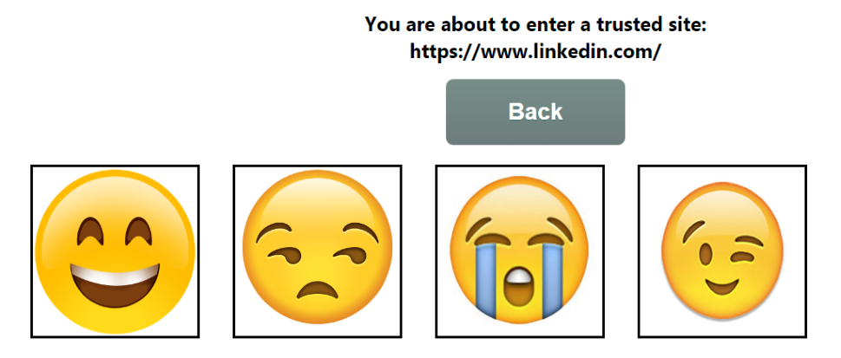



Browsing-Interaction Defenses
Interactive Site-Identifying Images
User surfs to trusted site, e.g., Linkedin
If the user clicks on the wrong image then the add-on warns him
Notes:
Before entering a protected website, user must select her agreed-upon image out of 4 images

Slide 15
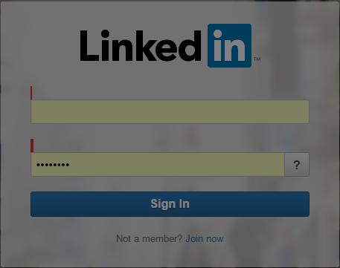
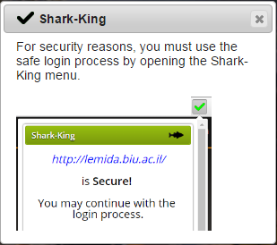
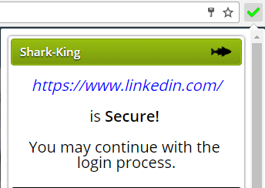
Browsing-Interaction Defenses
Interactive Anti-Phishing Button
User surfs to trusted site, e.g., Linkedin
Notes:
Before entering a protected website, user must double click the add-on icon

Slide 16
Browsing-Interaction Defenses
Interactive Anti-Phishing Button
User surfs to trusted site, e.g., Linkedin
Notes:
Before entering a protected website, user must double click the add-on icon

Slide 17
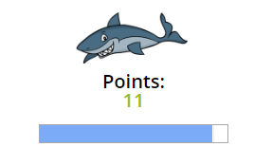
Training Defenses
Tests with Feedback
Continuous training and feedback
Tests are done during normal use of the system, for the entire duration of the experiment
Providing both negative and positive feedback in real-time
Score feedback for 75% of the participants
We used this mechanism alone and in conjunction with the browsing-interaction defenses (Images and Button)

Slide 18
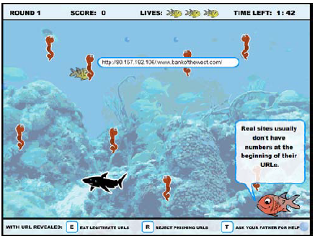
Training Defenses
Educational Phishing-Detection Game
An interactive game that trains the user to discern between phishing websites and authentic websites (Sheng et al., 2007)
One-time training method without additional defense mechanisms
Before participants began the long term experiment.
Notes:
Anti-Phishing Phil, an interactive game that trains the user to discern between
phishing websites and authentic websites. They conducted a short term experiment
to evaluate the game’s effectiveness.

Slide 19
Outline
Introduction
Anti-Phishing Defenses
Phishing Attacks
Hypotheses
Experiment Results & Analysis
Conclusions

Slide 20
Phishing Attacks
Attacks Categories
Attacks Depending on User’s Action
The opportunity to activate the attack depends on the user’s current actions and intentions
Independent Attacks
May be launched on the user randomly on any website and at any time
Bringing User to a Phishing Website
Direct the user to a phishing website, and not (directly) steal the user’s private information
Notes:
יכולות להיות התקפות שמשויכות ליותר מקטגוריה אחת

Slide 21

Phishing Attacks
Classic Phishing Attack
We purchased 24 domains, which impersonate 10 popular domains and created a total number of 119 different phishing websites.
Where the original domains have secure implementation of HTTPS, we also provided secure implementation of HTTPS for the phony domains.
User surfs to authentic site, e.g., eBay

Slide 22
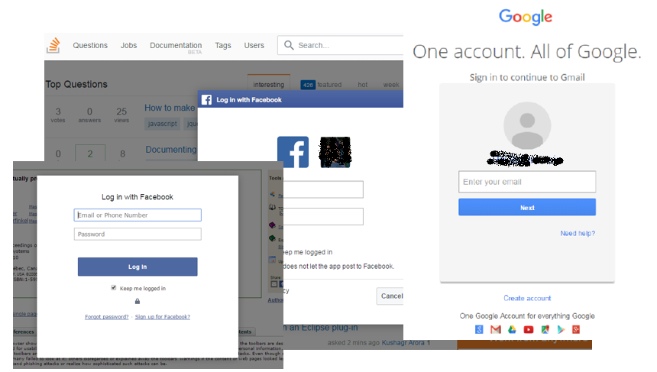
Phishing Attacks
Pop-Up Phishing Attack
Notes:
The popup
window contains a fake login form that ‘covers’ the original website page. The
pop-up is hard to detect, since it does not display its own URL. As a result, users
may not notice that this is a fake pop-up. We implemented six variants of pop-up
windows: two Facebook login forms, with and without user’s Facebook account
image; and two variants of Gmail login forms, each with and without the account
name. This allowed us to measure the potential vulnerability to phishing attacks
due to the exposure of basic private information such as name and image.

Slide 23
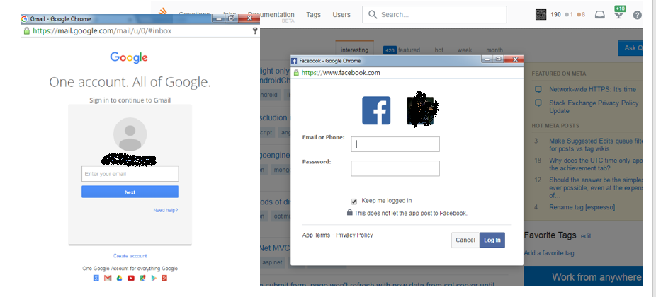
Phishing Attacks
Picture in Picture Pop-Up Phishing Attack

Slide 24
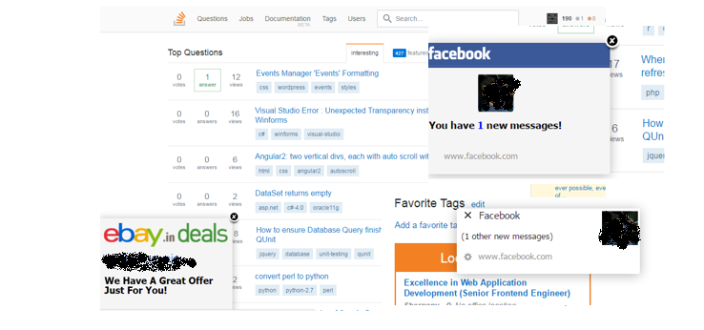
Phishing Attacks
Advertisement with Pop-Up Phishing Attack
20 different variants for this attack type
Notes:
To test the impact of showing the user private
information, each ad had two versions: one with and one without personal
user information. We also took advantage of PC desktop notifications to forge
advertisements that look like Facebook desktop notifications.

Slide 25


Phishing Attacks
Change (fake) Links Attack
Notes:
To avoid harming the usability, this attack does not launch
on the attacked entities’ websites (e.g., Facebook, Gmail), but on other websites
that contain links to those entities.

Slide 26

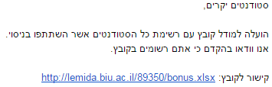
Phishing Attacks
Phishing Emails Attack
Notes:
At the bottom of the email was a legitimate link, but when the participants
clicked on this link, they were directed to a corresponding phishing website.

Slide 27
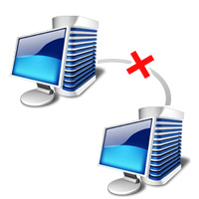
Phishing Attacks
Disconnections Attack
Disconnecting the user from an account she possesses (e.g., Facebook or Gmail)
The goal: participants get used to being asked to re-login to these sites during (other) attacks
Most users use cookies to skip the login form

Slide 28
Phishing Attacks
Images Identification Process Attack
Relevant only for Images group
Display four images, where none of them is the one preselected by the user

Slide 29
Phishing Attacks
Attacks never used in previous experiments
Pop-up phishing, Picture in Picture Pop-up phishing, Advertisement with pop-up phishing, Changed (fake) Links, Images Identification Process Attack
Attacks with and without private information
Pop-up phishing, Picture in Picture Pop-up phishing, Advertisement with pop-up phishing

Slide 30
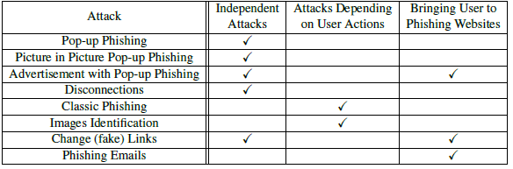
Phishing Attacks
Categorization of the attacks in use

Slide 31
Outline
Introduction
Anti-Phishing Defenses
Phishing Attacks
Hypotheses
Experiment Results & Analysis
Conclusions
Notes:
Only some of the main hypotheses

Slide 32
Hypotheses
Browser Interaction Defenses
Training with Game and Feedback
Long Term Realistic Evaluation
User Privacy

Slide 33


Hypotheses (1/4): Browser Interaction Defenses
Browsing interaction defenses will have better detection and worse usability
The Images and the Button mechanisms are roughly equally effective in their detection, but the Images group is less usable

Slide 34
Hypotheses (2/4): Training with Game and Feedback
Continuous training improves detection and reduces usability
One-time training also improves detection, but this improvement deteriorate over time
Higher training frequency improves detection and reduces usability
Score feedback mechanism improves both detection and usability

Slide 35
Hypotheses (3/4): Long Term Realistic Evaluation
The results of a short-term experiment are not a reliable indicator for the results of a long-term experiment

Slide 36
Hypotheses (4/4): User Privacy
Phishing attacks that display private information of the victim, have a lower detection rate

Slide 37
Outline
Introduction
Anti-Phishing Defenses
Phishing Attacks
Hypotheses
Experiment Results & Analysis
Conclusions

Slide 38
Demographic data
134 participants
68% male and 32% female
90% undergraduate computer science students
Period of five weeks for each participant
Overall experiment time was from November 16 to January 17
None of the participants had prior knowledge about the experiment and all had the free choice to join or not to join
Participants could leave the experiment at any time they wanted and get paid according to the period of time they were part of the experiment
Appropriate IRB approval

Slide 39
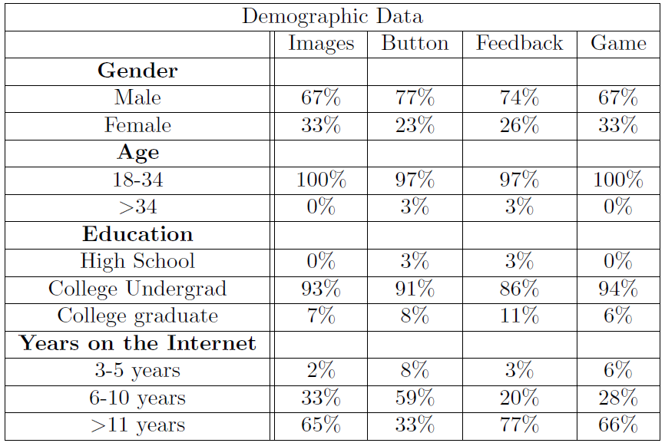
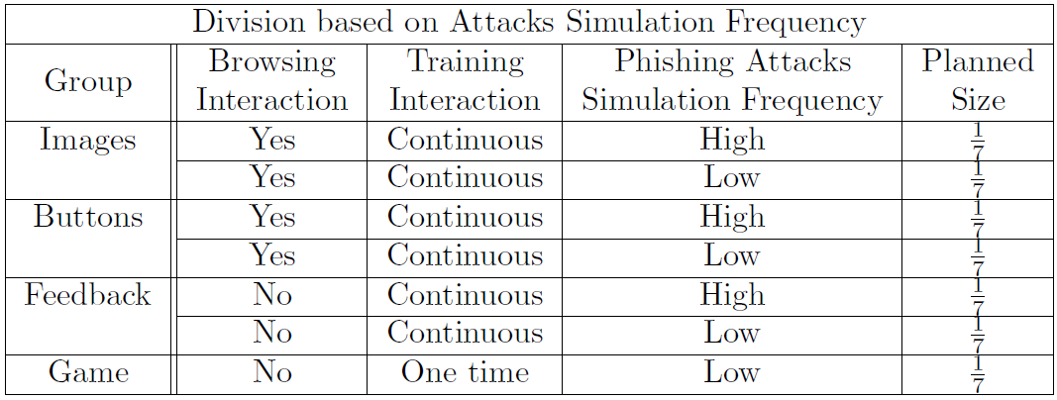
Long-Term Experiment
Groups and demographic data

Slide 40
Long-Term Experiment Challenges
Realistic Environment
Long period of five weeks
More accurate evaluation than a short-term experiment
Compare the results of short-term experiments to those of longer-term
Implemented as Chrome browser add-on (Product quality)
Popular and used normally by the participants
Sufficient number of participants (134)
Maintain attacks rare and unexpected
real usage conditions
Notes:
Popular and used normally by the participants – it isn’t increase user awareness to tested environment

Slide 41
Experiment Life Cycle
Short-term experiment
Installation, registration, and grouping
First time 10 URLs test
Training (according to group type)
Second time 10 URLs test
Long-term experiment
First week without attacks (reduces users’ awareness)
Second until fifth weeks
Notes:
A, B groups

Slide 42
Long-Term Experiment
Evaluate and compare different defenses and attacks
New defense mechanism, Feedback
Extensive evaluation for defenses that proposed previously
Evaluate effective and realistic attacks never used in previous experiments
Measuring the impact of private information (attacks)

Slide 43
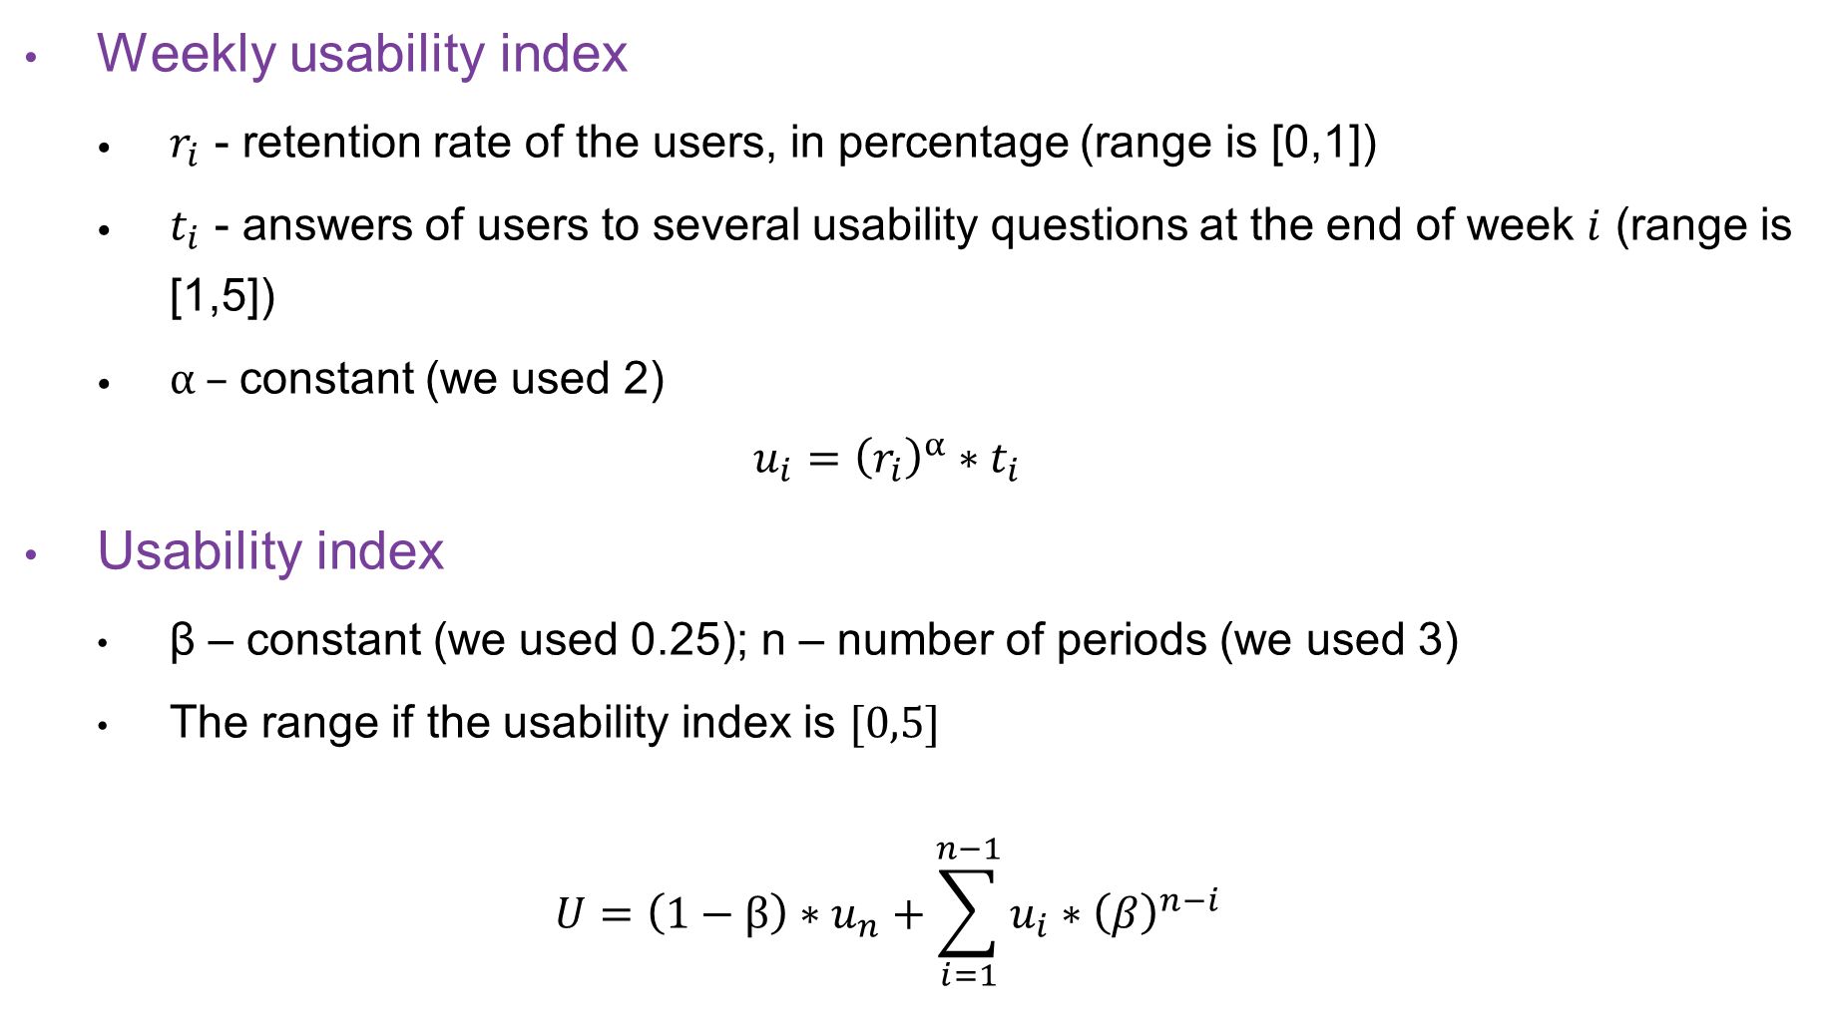
Usability Index
The sensitivity to the index was examined
Weekly usability index
$r_{i}$ - retention rate of the users, in percentage (range is [0,1])
$t_{i}$ - answers of users to several usability questions at the end of week $i$ (range is [1,5])
α – constant (we used 2)
$$u_{i}={\left(r_{i}\right)}^{α}∗t_{i}$$
Usability index
β – constant (we used 0.25); n – number of periods (we used 3)
The range if the usability index is $[0,5]$
$$U=\left(1−β\right)∗u_{n}+\sum_{i=1}^{n−1}{u_{i}∗{\left(β\right)}^{n−i}}$$
The sensitivity of the index was examined

Slide 44
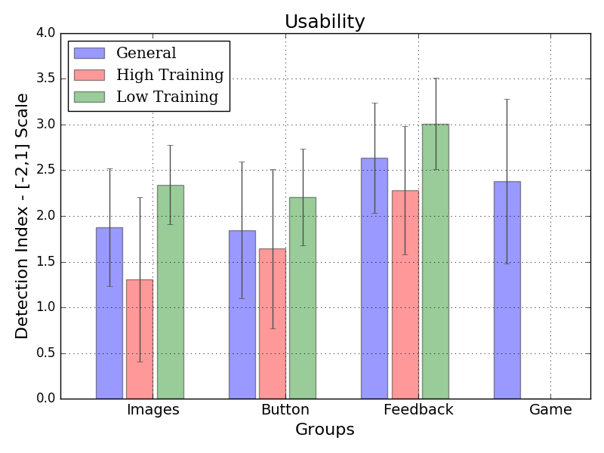
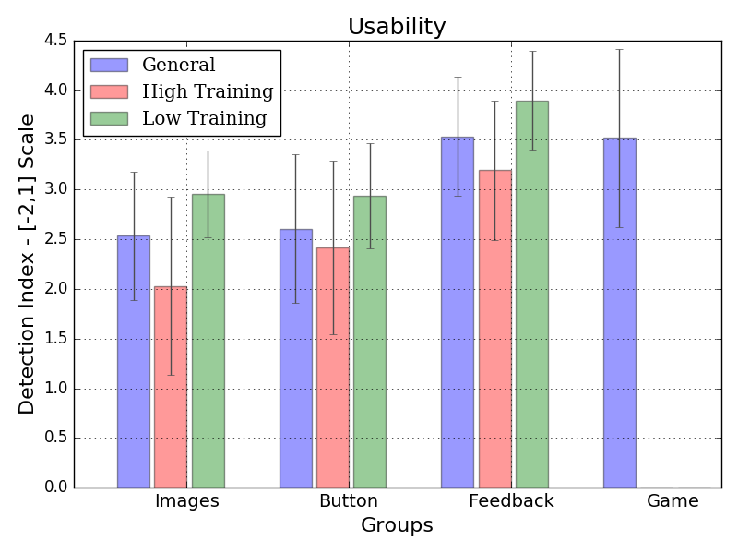
Sensitivity for Indexes Parameters
Usability Index
We tested several values for α, β
Groups remains in the same order
Changes in β only affect the scale
e.g., pics. β =0.25 and β =0.5
When α=1 the difference between Feedback and other group usability is still significant (p-value is a bit higher)
Detection Index
We tested several values for α
Groups remains in the same order
When α=0, indexes were higher significantly for all groups
When α=1, indexes were higher for all groups
Notes:
Both usability and detection indexes uses constant parameters.

Slide 45
Results & Analysis
Evaluation of UI Defenses
Feedback Frequency and Score
Long-Term Realistic Evaluation
Privacy
Re-Validation of Previous Experiments

Slide 46

Evaluation of UI Defenses: Usability Long-term Experiment
Browsing-interaction defenses (Button and Images) are significantly less usable than the training defenses (Feedback and Game)
Significant usability advantage to the Feedback defense over other defenses, even over Game defense
Notes:
users enjoyed the challenge of detecting phishing sites
Feedback mechanism made the users more confident in their ability to detect phishing sites (there is no extra guidance)

Slide 47
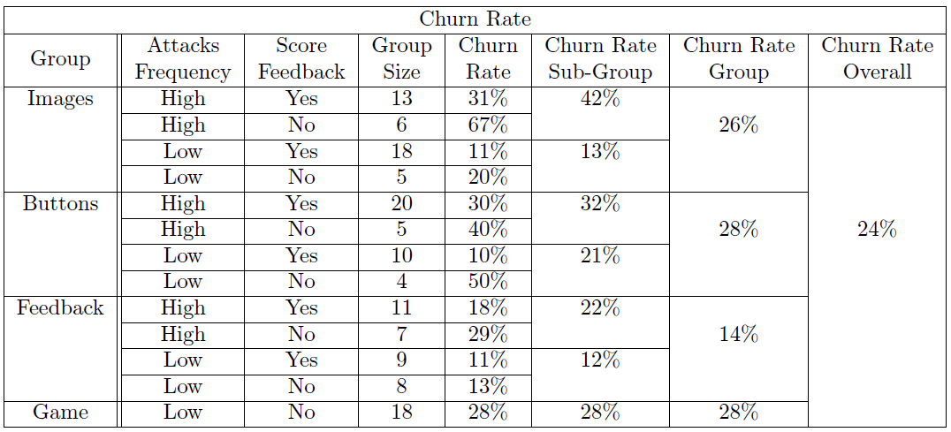
Results & Analysis
Evaluation of UI Defenses
Usability

Slide 48
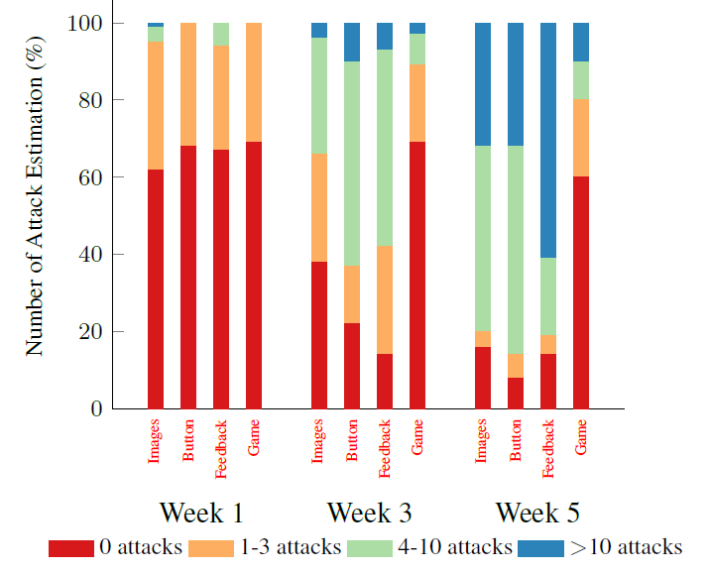
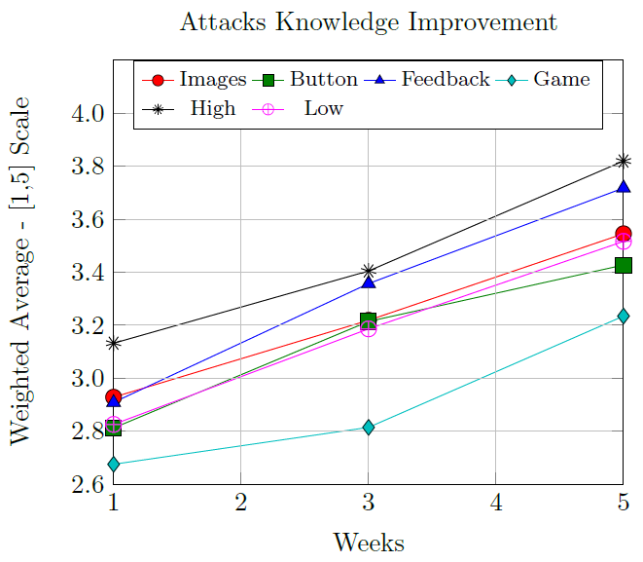
Results & Analysis
Evaluation of UI Defenses
Usability

Slide 49
Results & Analysis
Evaluation of UI Defenses
Usability
Browsing-interaction defenses (Button and Images) are significantly less usable than the training defenses (Feedback and Game)
Significant usability advantage to the Feedback defense over other defenses, even over Game defense
users enjoyed the challenge of detecting phishing sites
Feedback mechanism made the users more confident in their ability to detect phishing sites (there is no extra guidance)

Slide 50
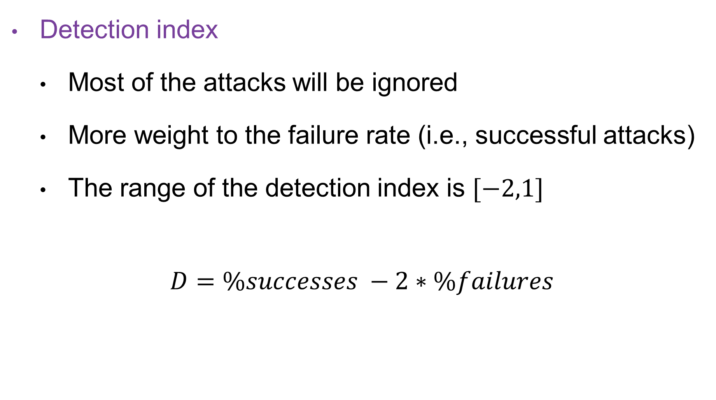
Detection Index
Detection index
Most of the attacks will be ignored
More weight to the failure rate (i.e., successful attacks)
The range of the detection index is $[−2,1]$
$$D=\%successes −2∗\%failures$$

Slide 51
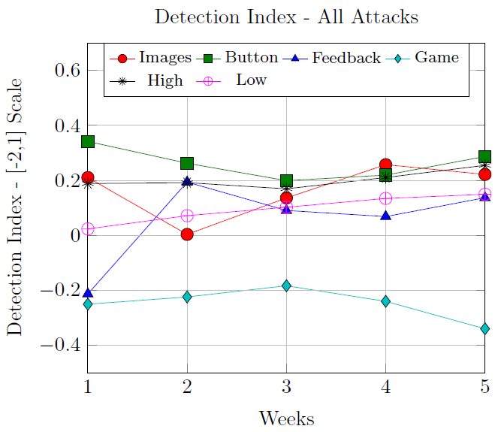
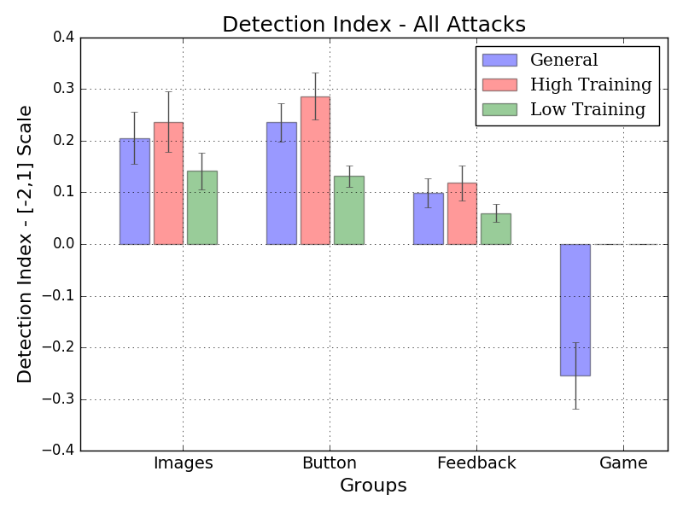
Evaluation of UI Defenses: Detection Long-term Experiment
Browsing-interaction defenses (Button and Images) have significantly higher detection indexes than the training defenses (Feedback and Game) both separately and together
Notes:
Button performed better than Images, but not significantly
Images performed significantly better than Feedback
Feedback performed significantly better than Game

Slide 52
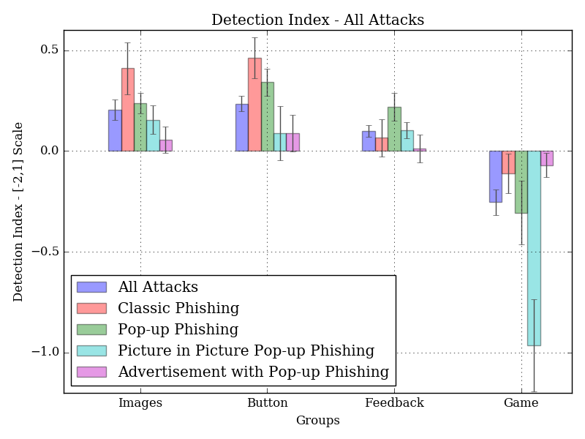
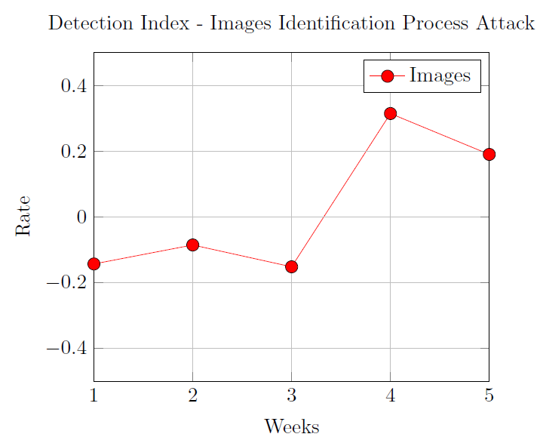
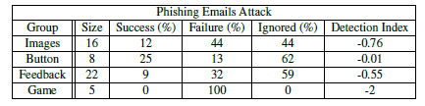
Attack Comparison
Attacks for all groups
Images Identification Attack
Phishing Email Attack
Browsing-interaction defenses (Button and Images) have significantly higher detection indexes than the training defenses (Feedback and Game) for Classic Phishing Attack

Slide 53
Attack Comparison
Attacks for all groups
Images Identification Attack
Phishing Email Attack
Picture in Picture Pop-up Attack has significantly lower detection indexes than Pop-up Phishing Attack

Slide 54
Attack Comparison Long-term Experiment
Browsing-interaction defenses (Button and Images) have significantly higher detection indexes than the training defenses (Feedback and Game) for Classic Phishing Attack

Slide 55
Attack Comparison Long-term Experiment
Picture in Picture Pop-up Attack has significantly lower detection indexes than Pop-up Phishing Attack

Slide 56
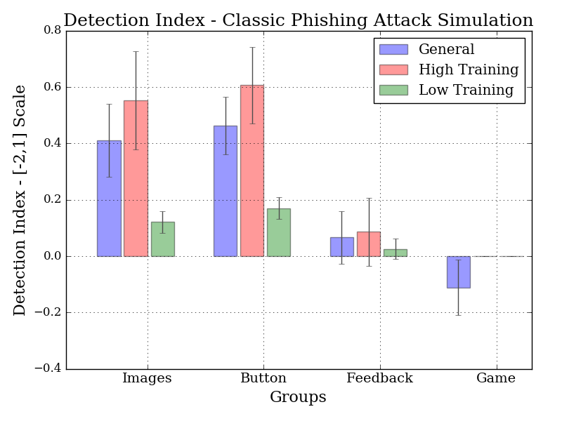
Classic Phishing Attack Simulation

Slide 57
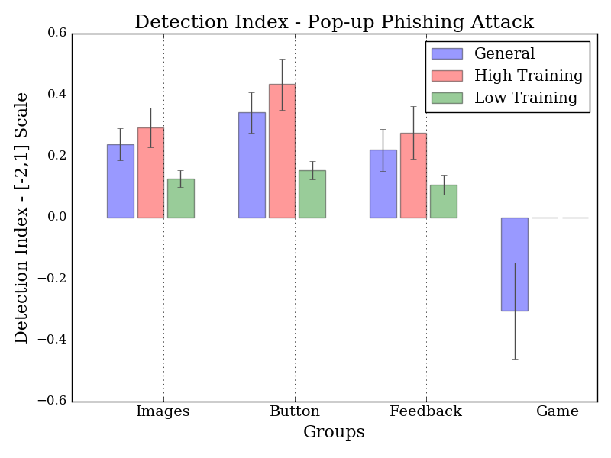
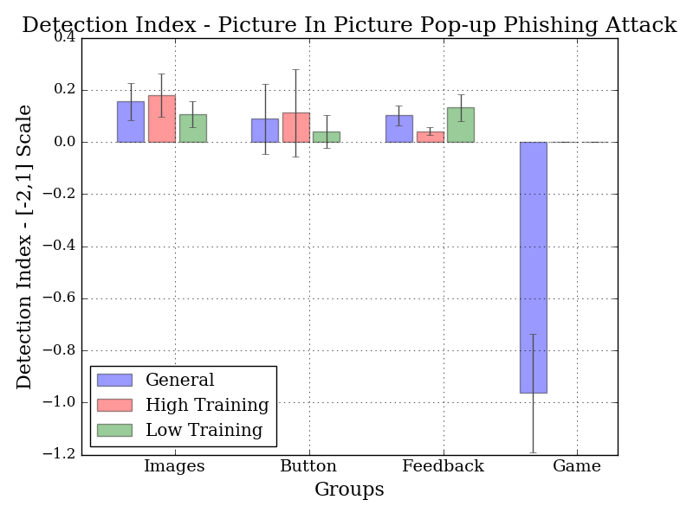
Pop-ups Phishing Attack
Pop-up Attack
Picture in Picture Pop-up Attack

Slide 58
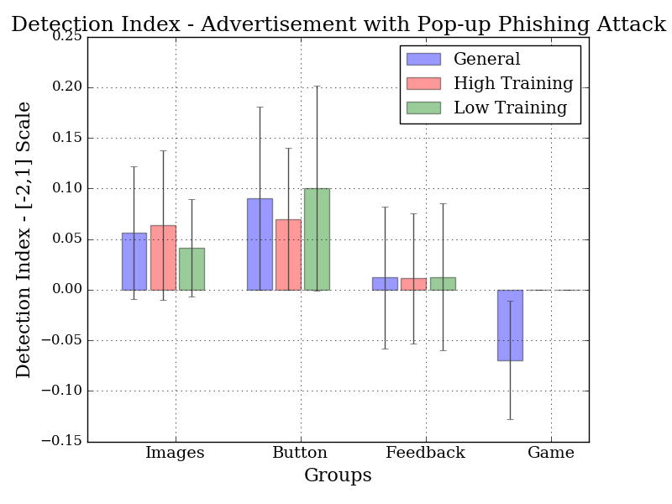
Additional Attacks
Images Identification Attack
Advertisement Attack
Phishing Email Attack

Slide 59
Results & Analysis
Evaluation of UI Defenses
Detection long-term experiment
Browsing-interaction defenses (Button and Images) have significantly higher detection indexes than the training defenses (Feedback and Game) both separately and together
Button performed better than Images, but not significantly
Images performed significantly better than Feedback
Feedback performed significantly better than Game

Slide 60
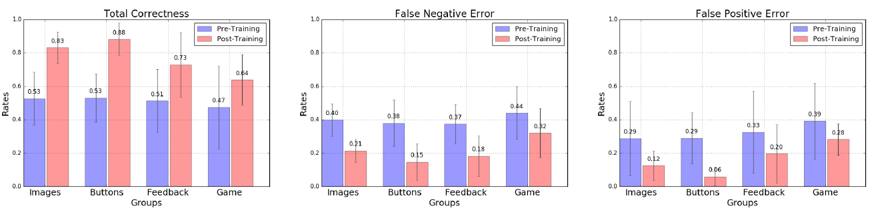
Evaluation of UI Defenses: Short-Term Experiment
Total Correctness
False Negative Error
False Positive Error
The correctness increased significantly for all group types between the pre-training and post-training steps
Browsing-interaction defenses (Button and Images) achieved the highest detection rates and lowest error rate
Notes:
FN – phishing consider as real, FP – real consider phishing
Button performed significantly better than Images
Images performed significantly better than Feedback
Feedback performed significantly better than Game
For the Game group, our experiment re-validates the (very similar) experiment of Sheng et al. ‘Anti-Phishing Phil’

Slide 61
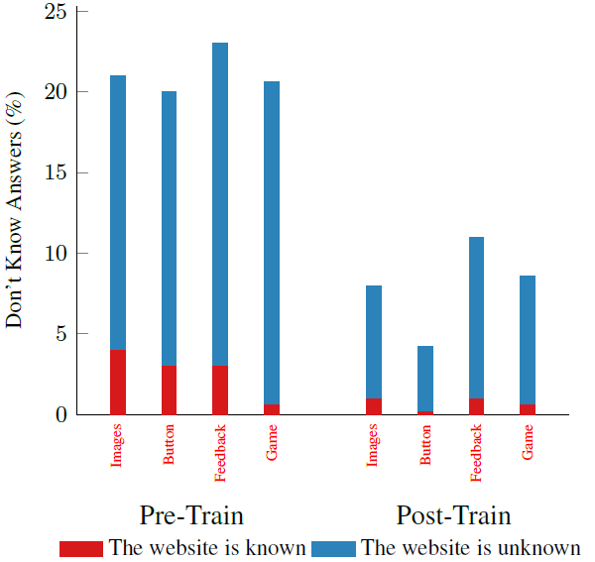
Evaluation of UI Defenses: Short-Term Experiment
Training Improves the confidence of users in their ability to detect phishing sites

Slide 62
Results & Analysis
Evaluation of UI Defenses
Short-term experiment
The correctness increased significantly for all group types between the pretraining and post-training steps
Browsing-interaction defenses (Button and Images) achieved the highest detection rates and lowest error rate
Button performed significantly better than Images
Images performed significantly better than Feedback
Feedback performed significantly better than Game
For the Game group, our experiment re-validates the (very similar) experiment of Sheng et al. ‘Anti-Phishing Phil’

Slide 63
Evaluation of UI Defenses: Short-Term Experiment are Unreliable
Short-term experiments are not a reliable indicator for the results of long-term experiments
Participants are overly aware of being tested
The ‘ignored’ option is common for long-term experiments
Detection rates change over time
Significant difference between the two training defenses (Feedback and Game)
Based on the short-term experiment, Game is a better candidate
Based on the long-term experiment, Feedback is a better candidate
Notes:
Based on the short-term experiment, Feedback and Game have similar detection rates, but intuitively Game have much better usability scores.
Based on the long-term experiment, detection results of the Game mechanism quickly deteriorated and were far below those of the other three defenses. The results of the Feedback mechanism steadily improved and are quite comparable to those of the interactive browsing defenses. Furthermore, the usability of the Feedback mechanism turned out to be excellent, even slightly above that of the Game mechanism.

Slide 64
Evaluation of UI Defenses: Short-Term Experiment are Unreliable
Significant difference between the two training defenses (Feedback and Game)
Based on the short-term experiment, Game is a better candidate
Based on the long-term experiment, Feedback is a better candidate
Images and Button groups
Detection index is significantly higher in short-term experiment
Usability index is significantly higher at the start of the experiment
The ‘ignored’ option is common for long-term experiments
Notes:
Based on the short-term experiment, Feedback and Game have similar detection rates, but intuitively Game have much better usability scores.
Based on the long-term experiment, detection results of the Game mechanism quickly deteriorated and were far below those of the other three defenses. The results of the Feedback mechanism steadily improved and are quite comparable to those of the interactive browsing defenses. Furthermore, the usability of the Feedback mechanism turned out to be excellent, even slightly above that of the Game mechanism.

Slide 65
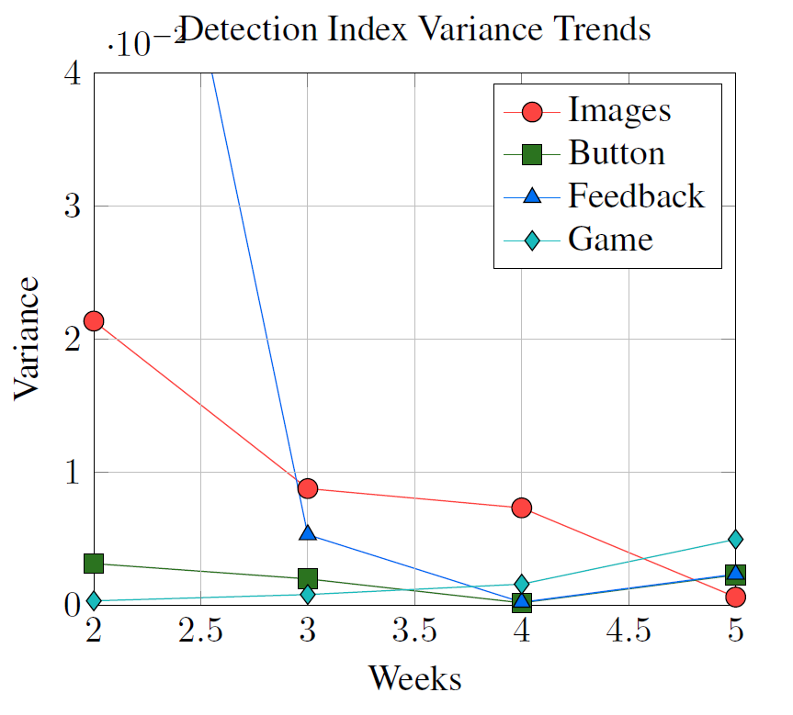
Detection Index Variances Trends
Detection index variances are stable and lower during the last three weeks of the long term experiment for all group types, i.e., more accurate and realistic results
Notes:
Large variances indicate extreme
changes, where participants are still adjusting to the mechanism and/or have
high awareness of the experiment. On the other hand, small variances indicate that
the distribution of detection index values is near the average and will not change
significantly; these give more accurate and realistic results.

Slide 66
Feedback and Training Defenses: Usability
High training frequency reduced usability (graph)
High training frequency results in higher churn rate, 32% vs. 15% (table)
Score feedback improves usability and had lower churn rate, 20% vs. 34%
On the other hand, high training frequency group had highest knowledge growth estimation (graph)

Slide 67
Feedback and Training Defenses: Detection
Participants with a higher training frequency had a significantly higher detection index (graph)
Score feedback improves detection index but not significantly
Game group detection index decreases but not significantly
Notes:
Continuous training groups (i.e., Images, Button and Feedback)
Detection index increases significantly between the first and last three weeks of the long-term experiment

Slide 68
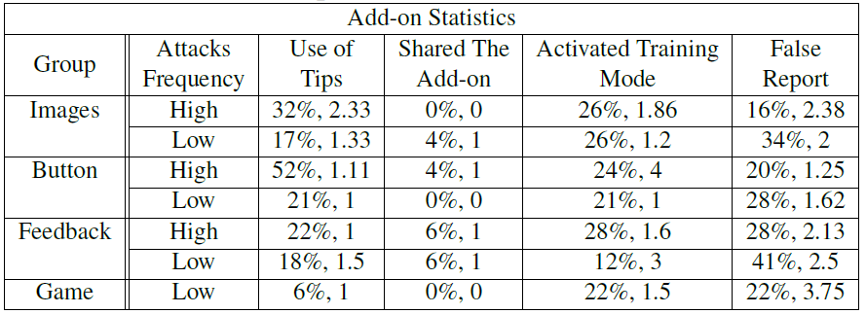
Results & Analysis
Feedback and Training Defenses
Tips and Training Mode
25% of the participants used the optional tips
23% of the participants used optional training mode
15% of the participants used both tips and training mode
Notes:
Our results confirm that these mechanisms were used by a significant fraction of the users, but we do not have enough data to evaluate their effectiveness or provide recommendations on their use and design. Further research is required.

Slide 69
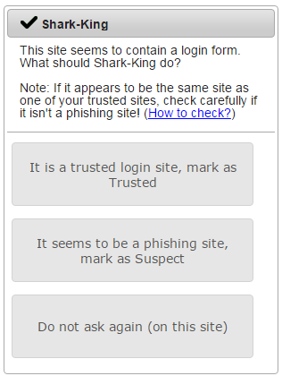
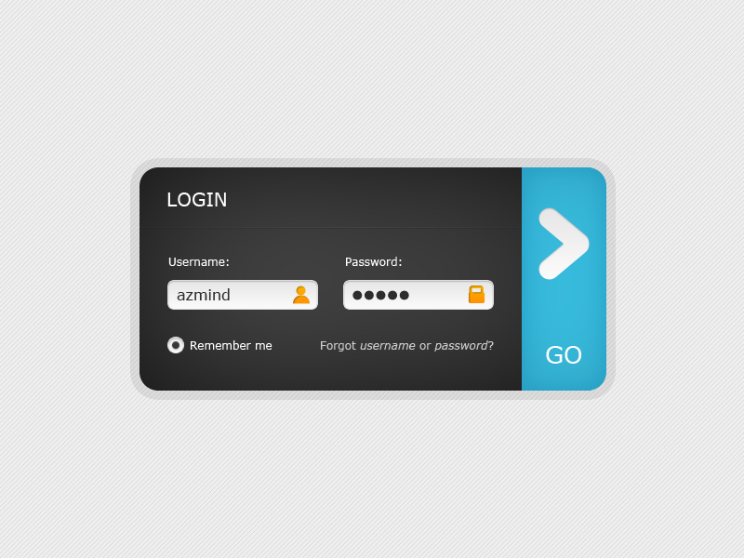
Results & Analysis
Feedback and Training Defenses
Auto-suggestions Methods
For example: login form recognition

Slide 70
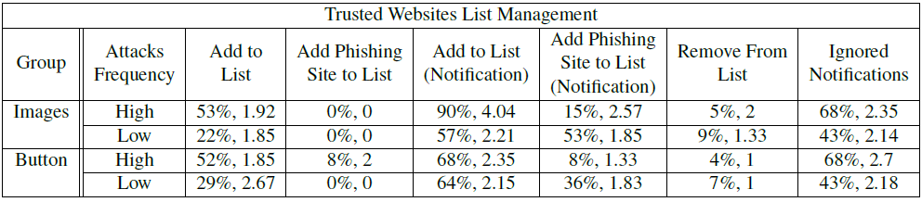
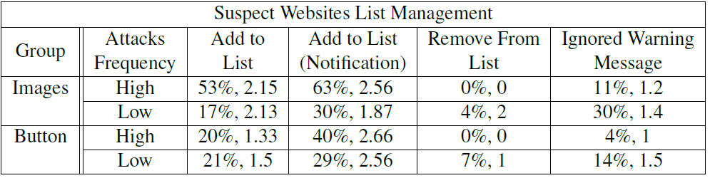
Results & Analysis
Feedback and Training Defenses
Auto-suggestions Methods
Notes:
The methods include notifications which designed to help the participants to improve their interactive UI use such as a login form recognition which help the participants to get the right decision about the website essence, warning messages when the participants enter a suspect website and more.

Slide 71
Results & Analysis
Feedback and Training Defenses
Auto-suggestions Methods
Majority of the participants act according to the suggestions at least one time (74%)
Login form recognition instead of helping the participants turn out to be two-edged sword and decreases user security
Maybe they considered it as recommendation
Warning messages when the participants enter a suspect website worked perfectly
No attempt was made to add trusted website to the suspect websites list

Slide 72
Results & Analysis
Long-Term Realistic Evaluation
Results from the three last weeks of the long term experiment are more realistic and reliable
Short term experiments show only a partial picture of the actual real results
Detection index for continuous training groups (i.e., Images, Button and Feedback) increases significantly between the first and last three weeks of the long-term experiment (graph)
Detection index variances are stable and lower during the last three weeks of the long term experiment for all group types, i.e., more accurate and realistic results
Notes:
Large variances indicate extreme
changes, where participants are still adjusting to the mechanism and/or have
high awareness of the experiment. On the other hand, small variances indicate that
the distribution of detection index values is near the average and will not change
significantly; these give more accurate and realistic results.

Slide 73
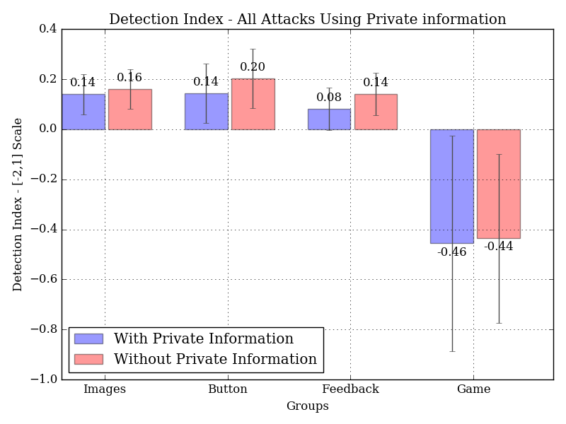
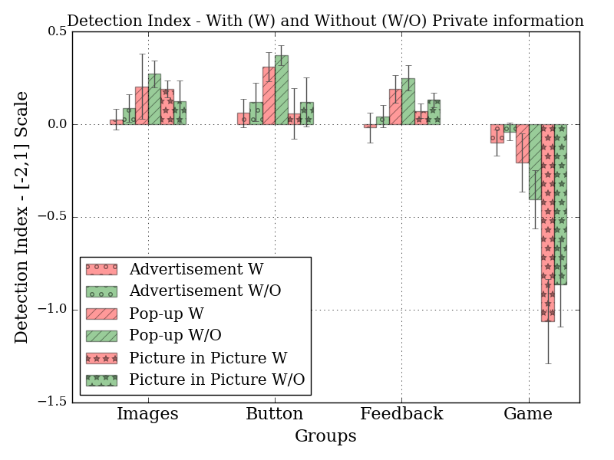
User Privacy: All Attacks Using Private Information
Phishing attacks containing private user information are harder to detect
Reflect the danger of revealing private user information
Notes:
Participants do better recognizing attacks that do not have private information, as compared to recognizing the same attacks when private user information is displayed

Slide 74
Results & Analysis
Re-Validation of Previous Experiments
Sheng et al., 2007
Our short-term experiment re-validates the experiment of Sheng et al. ‘Anti-Phishing Phil’ for Game group
Detection rates improve significantly after playing the game
Long term experiment shows that this improvement deteriorates over time.
The game does not teach general concepts for defense against phishing attacks beyond the specific attacks included in the game.
Notes:
One of the concepts covered by the game is ”A company name
followed by a hyphen usually means it is a scam site”. In our short term experiment,
we tested four websites with a hyphen in the URL. The correctness for those websites
was 0.74 for the Game group, which is above the overall correctness (0.64,
see Figure 25).

Slide 75
Results & Analysis
Re-Validation of Previous Experiments
Herzberg and Margulies, 2011
Images group is a variant of their mechanism, provided by browser add-on rather than by the website
More realistic evaluation
Tested on 119 different websites (cf. single website known in advance to the participants)
Various types of phishing attacks (cf. smaller variety)

Slide 76
Results & Analysis
Re-Validation of Previous Experiments
Herzberg and Margulies, 2011
The realistic evaluation caused to our general detection rates to be somewhat lower than those reported in their work
But, for the same attacks (e.g., Classic Phishing Attack Simulation), the differences are reasonable (74% vs. 60%).

Slide 77
Results & Analysis
Re-Validation of Previous Experiments
Jakobsson and Siadati, 2016
Button group is a variant of their mechanism, provided by PC browser add-on rather than mobile browser (Zirco)
Both works showed high usability for the mechanism
Results of an attack on the login process procedure, in their work, had lower detection index than results for Button group
Notes:
56% of the participants selected the response ‘I got used to it quickly’, which represents the
general usability of their method. Although our measurement is different, we also
found a reasonable usability index for the Button group of 2.98
Jakobsson and Siadati also conducted an attack on the login process procedure,
in which participants were asked not to press the power button, and to enter their
email password instead of the password used in the experiment. The participants’
success rate against this attack was 27% and the failure rate was 15%, i.e., detection
index =-0.03. Our results for the Button group show a slight improvement.

Slide 78
Outline
Introduction
Anti-Phishing Defenses
Phishing Attacks
Hypotheses
Experiment Results & Analysis
Conclusions

Slide 79
Conclusions
Detection
Usability
Images
Game
Feedback
Button
Notes:
קבוצות הכפתורים תמונות ופידבק שמשלבות אימון קבוע לאורך כל תקופת הניסוי מארות מדד זיהוי טוב יותר אך יוזביליטי פחות טוב

Slide 80
Conclusions
Button, Images, and Feedback mechanisms have a substantial advantage in detection rates
Feedback and Game mechanisms have an advantage in usability.
Feedback mechanism is a worthy candidate as an
additional defense mechanism for browsers
Notes:
Reset click whirr syndrome – automatically do the same action in order to log in

Slide 81
Conclusions
Short-term experiments are not a reliable indicator for the results of long-term experiments
Short-term and/or laboratory experiments present only partial picture of the actual real results
Last three weeks of the long-term experiment present more consistent and accurate results from those of the first weeks
Long-term evaluation is necessary

Slide 82

Questions?
Thank you !

